Slide 1
Cross Platform Mobile C#, Mvvm and DataBinding
WP7
Android
iPhone
iPad
Win 8

Slide 2

@slodge

Slide 3

http://bit.ly/mvvmcross

Slide 4
Coming up…
C# Cross Platform
An Mvvm Introduction
Some Code: TwitterSearch
Some Extras
Q&A

Slide 5
Mobile C#

Slide 6
Why C#?
You already have:
skills
tools
code
“low level”
compiles
testable
quick
Enables native look and feel on all platforms
Generics, Linq, Async and the future…

Slide 7
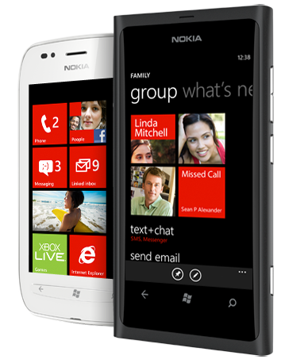

What you need – WP7:
A Windows 7 PC
Free Tools or better!
AppHub account $99
A phone sometimes helps…

Slide 8

What you need - Android:
Windows PC or a Mac
Free Tools
Play account $25
A phone really helps…
Mono 4 Android $400

Slide 9
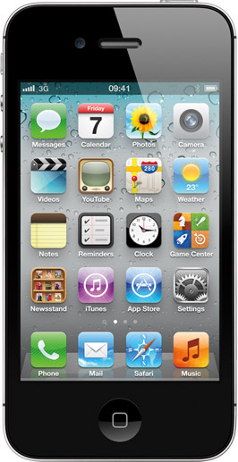
What you need - iOS:
An Intel-based Mac
Account-Linked Tools
iOS Account $99
A phone often helps…
MonoTouch - $400

Slide 10


Getting Started Links…

Slide 11
MVVM

Slide 12
Mvvm Basics
View
ViewModel
Model
View
ViewModel
Model
View
ViewModel
Model
get/set Properties
call Commands
Whatever C# you like!
notify changes
some messaging

Slide 13
MVVM Technical Details
Properties
INotifyPropertyChanged
INotifyCollectionChanged
Data Binding
IValueConverter
ICommand
UI Thread

Slide 14
Mvvm Benefits
The “normal” reasons:
Separation of concerns
Designability (Blendability)
Testability
The MvvmCross reason:
Cross platform code reuse

Slide 15
Mvvm Cross Platform
View
ViewModel
Model
View
ViewModel
Model
View
ViewModel
Model
get/set Properties
call Commands
Whatever C# you like!
notify changes
some messaging
Platform Specific
Shared

Slide 16



Some longer introductions…

Slide 17
Twitter Search

Slide 18
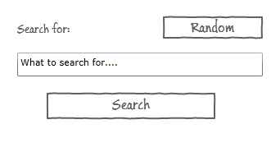

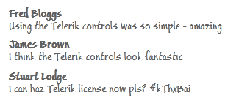
What we want to build…
Home Page:
Result Page:

Slide 19
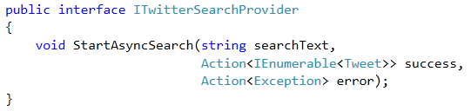
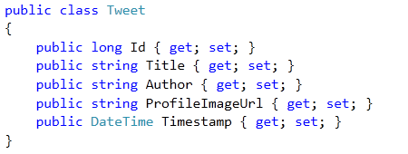
The Model and Service
STOLEN
From @ColinEberhardt

Slide 20
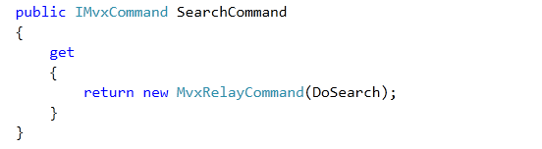
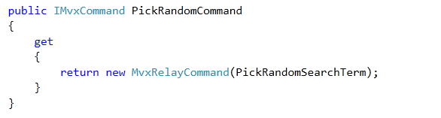
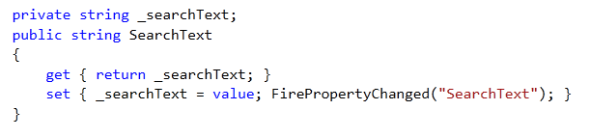
HomeViewModel

Slide 21
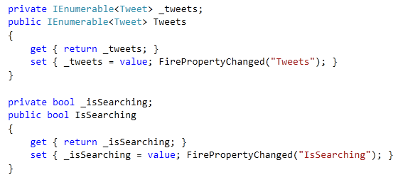
TwitterViewModel

Slide 22


Navigation
The HomeViewModel calls:
Which means the TwitterViewModel gets created with:

Slide 23
Test it!

Slide 24
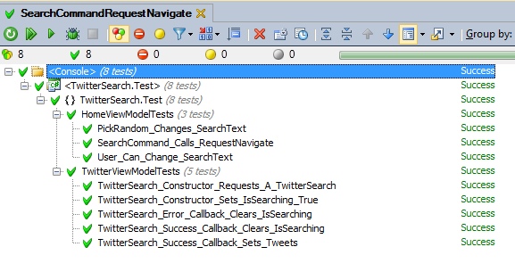
Some Unit Tests

Slide 25
“Win32”

Slide 26
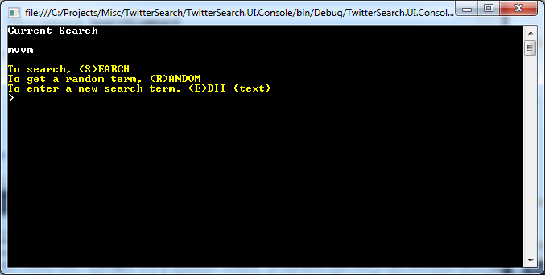
A Console App

Slide 27
WP7

Slide 28
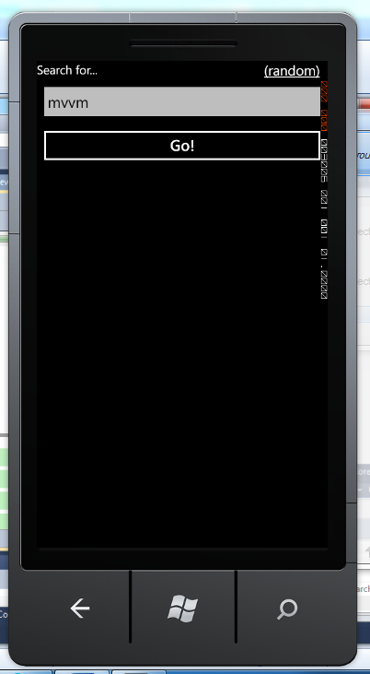
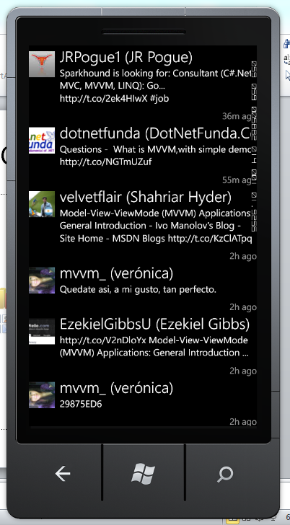
A WP7 App

Slide 29
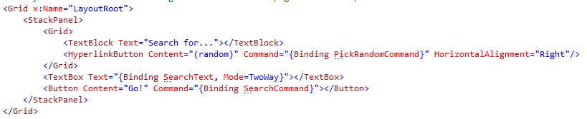
Inside WP7 App…
No C#, just XAML with {Binding}
Binding syntax includes:
{Binding Path, Converter=Converter, ConverterParameter=Parameter, Mode=Mode, FallbackValue=Fallback}

Slide 30
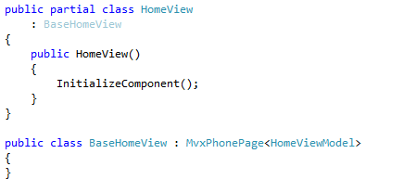
Inside WP7 App…
ViewModel is auto-wired via MvxPhonePage<TViewModel> inheritance

Slide 31
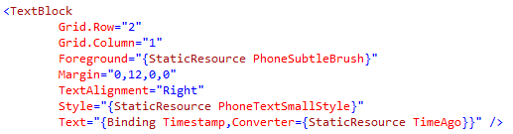
Inside WP7 App…
ValueConverters are used for presenting property values

Slide 32
Inside WP7 App…
Lists…

Slide 33
Inside WP7 App…
Navigation is mapped to XAML Uri’s – with parameters put in a JSON object in the path.
Implementation hidden from the View and ViewModel.

Slide 34
Android

Slide 35


An Android App

Slide 36
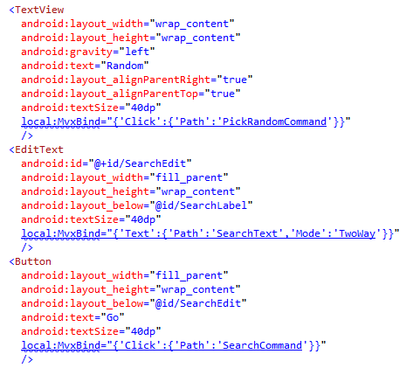
Inside Android App…
No C#, just xml with MvxBind attributes
MvxBind syntax is JSON based on XAML structure.

Slide 37
Binding – Xaml versus Mvx
WP7:
Text=“{Binding SearchText,Mode=TwoWay}”
Android:
local:MvxBind=“{‘Text’:
{‘Path’:’SearchText’,’Mode’:’TwoWay’}}”

Slide 38
Binding – Xaml versus Mvx
WP7:
Text=“{Binding Timestamp,Converter={StaticResource TimeAgo}}”
Android:
local:MvxBind=“{‘Text’:
{‘Path’:’Timestamp’,Converter’:’TimeAgo’}}”

Slide 39
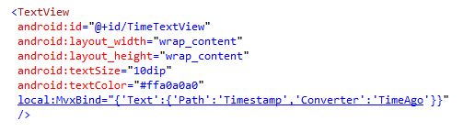
Inside Android App…
ValueConverters are used for presenting property values

Slide 40
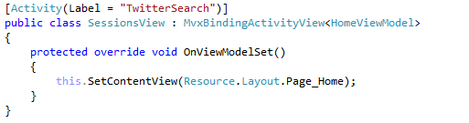
Inside Android App
ViewModels are auto-wired using MvxBindingActivityView<TViewModel> inheritance

Slide 41
Inside Android App…
Lists…

Slide 42
Inside Android App…
Navigation is mapped to Intent’s– with parameters put in a JSON object in the Extras.
Implementation hidden from the View and ViewModel.

Slide 43
iPhone

Slide 44
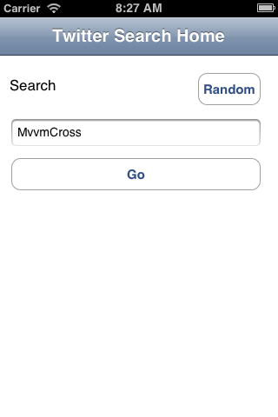

iPhone App

Slide 45
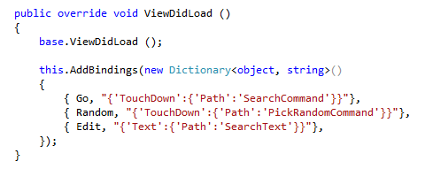
Inside iPhone App
UI is drawn in XML using Xcode
XIB is linked to C# classes using MonoTouch
Binding is declared in C# using JSON

Slide 46

Creating the XIB…

Slide 47
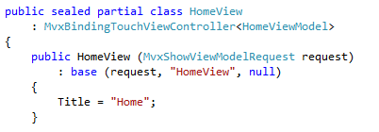
Inside iPhone App
ViewModels are auto-wired using inheritance and a constructor parameter:

Slide 48
Inside iPhone App
ValueConverters are used for presenting property values

Slide 49
Inside iPhone App
Lists…

Slide 50
Inside iPhone App
Navigation is mapped to C# calls.
Implementation mostly hidden from the View and ViewModel

Slide 52
iPad

Slide 53

iPad App

Slide 54

Inside iPad App
The iPad App is actually the iPhone App.
But the UI is different – take advantage of the larger screen.
Achieved in code: IMvxTouchViewPresenter

Slide 56
Windows 8 (WinRT/Metro)

Slide 57
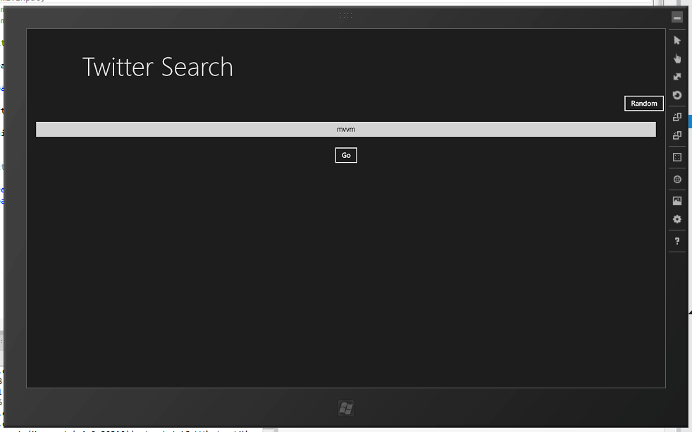

Windows 8 Metro App

Slide 58
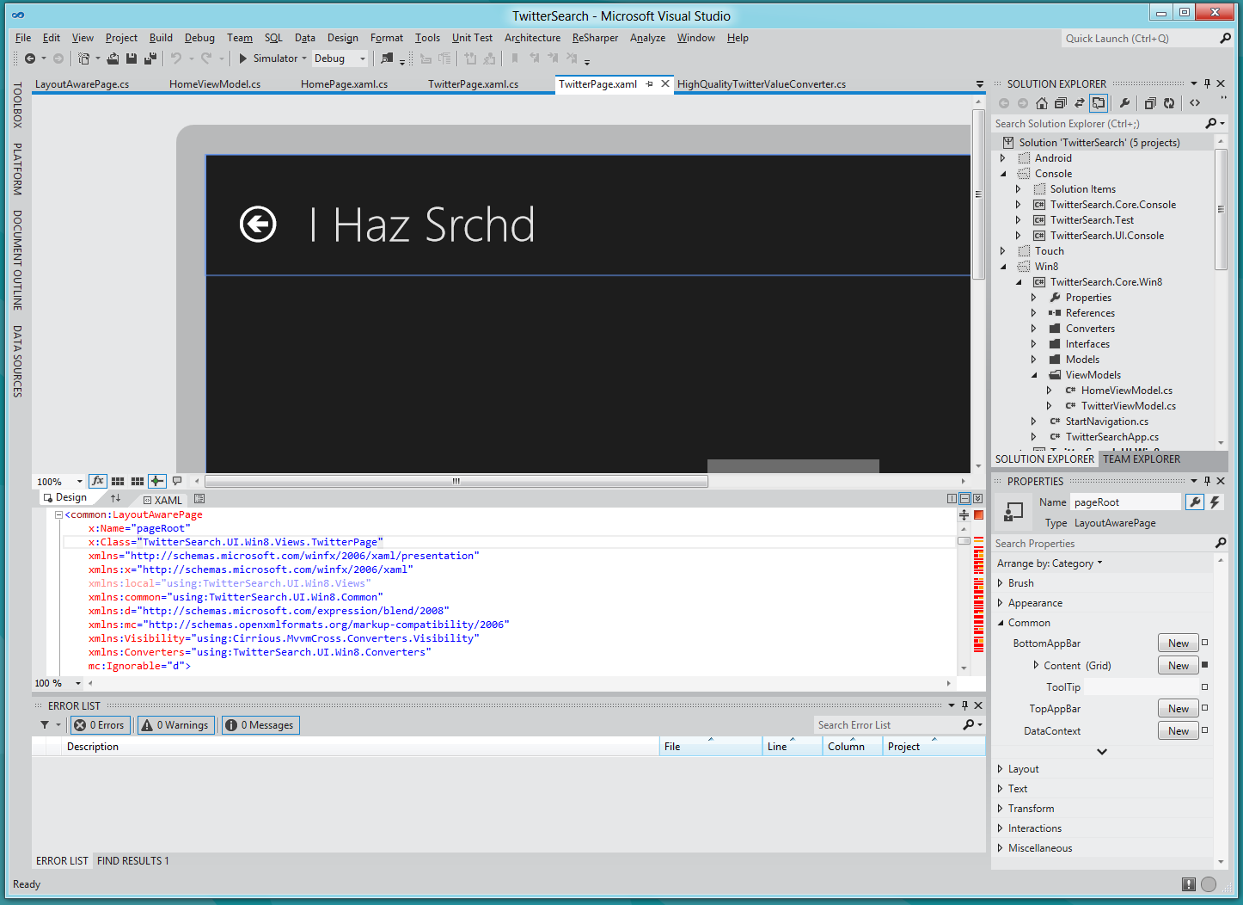
Inside Windows 8 Metro App…

Slide 59
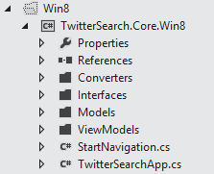
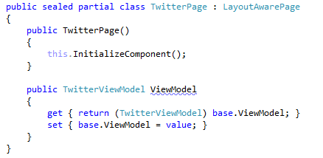
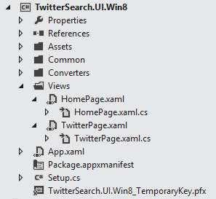
Inside Windows 8 Metro App…

Slide 60
Inside Windows 8 Metro App…
It’s like WP7….
No C#, just XAML with {Binding}
ValueConverters are used in Bindings
Lists are filled using ItemsSource
BUT: Navigation is achieved through code – not Xaml Uri’s

Slide 61

Inside Windows 8 Metro App
Warnings:
MvvmCross WinRT implementation is “first cut”
e.g. differences in ViewModel lifecycle
Under-the-hood Win8 implementation is native code – there are big differences.
differences in XAML
differences in .Net/C#
Everything is async.

Slide 62
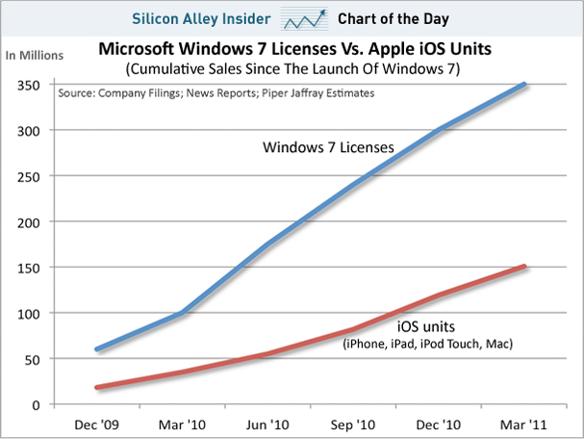
Inside Windows 8 Metro App…
Beyond the warnings – look at the numbers!

Slide 63
Recap

Slide 64

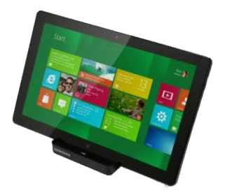



TwitterSearch recap…
Shared C# Core
ViewModels
Models
Services
Converters
Tests
UIs are “mostly XML/JSON”

Slide 65
Some Extras

Slide 66
Panoramas, Pivots and Tabs
Tabbed navigation is another common metaphor across phones and across ipads too.
Generally speaking think of each “tab” as its own ViewModel.
Binding is then available in each platform.

Slide 67
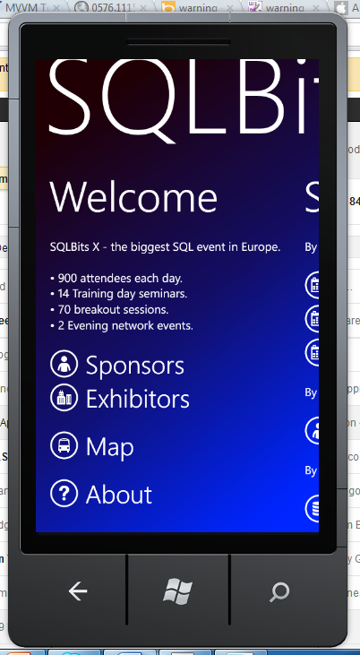

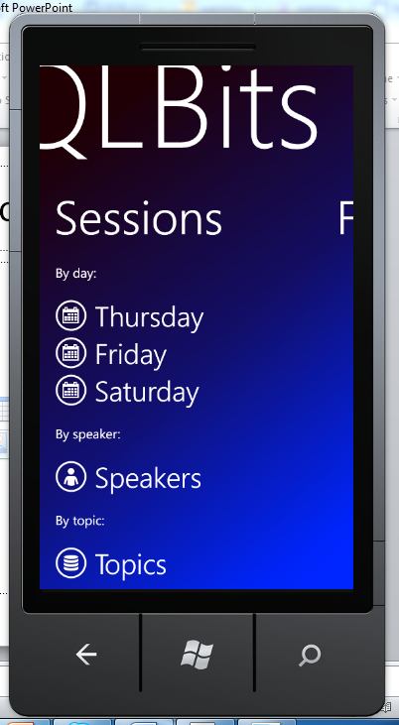

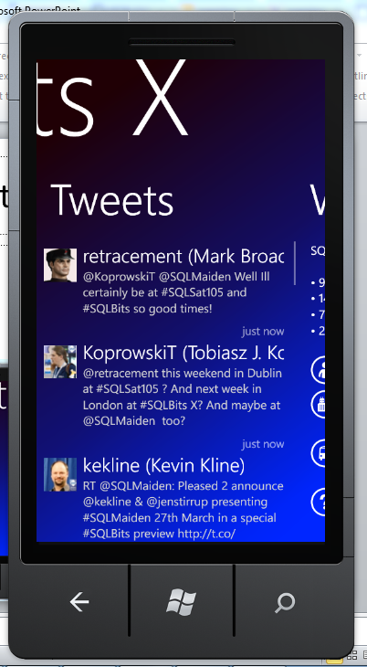

“Tabs”

Slide 68
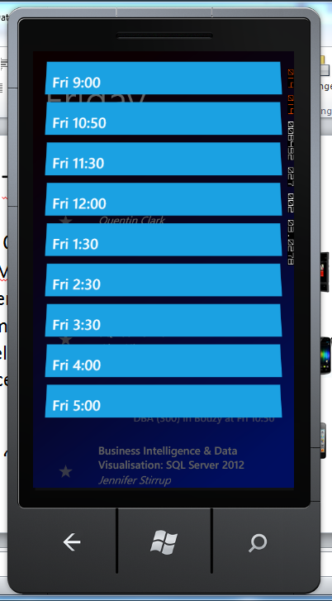
Jump Lists
Are possible…
But need separate list formats on each platform…
Thinking about how best to do this…
Open to ideas!

Slide 69
Dependency Injection
Useful for testing
Essential for injecting platform specific services – e.g:
Camera capture
GPS services
NFC
MvvmCross wraps OpenNetCF DI – adds some extension methods:
RegisterServiceInstance<TService>(instance)
RegisterServiceType<TService, TServiceType>()
GetService<TService>()

Slide 70
Native Types
Sometimes #define is necessary…
Personally, I try to use interfaces and DI wherever possible.

Slide 71
i18n
Choices:
Each platform has their own localisation format available.
Xamarin are supporting .resx files…
MvvmCross provides a .json file mechanism
Or write your own

Slide 72
Blendability
Limited support available right now.
It’s relatively easy to integrate your own design time ViewModelLocator with design time data…

Slide 73
Problems?
WinRT – issues…
Xcode designer - OMG
iOS development and debugging is most painful
Some compiler differences – JIT
Multiple “core” project files annoying – and breaks refactoring
MvvmCross still changing

Slide 74
That’s all folks

Slide 75
That’s all folks…
Hopefully we covered:
C# Cross Platform
An Mvvm Introduction
Some Code: TwitterSearch
Some Extras
There might be time for:
Q&A

Slide 76
@slodge

Slide 77
http://bit.ly/mvvmcross

Slide 78

Alternatives: http://bit.ly/rrnLDT

